Slide 1
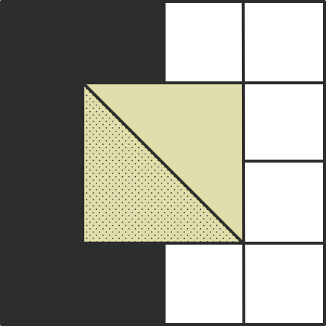
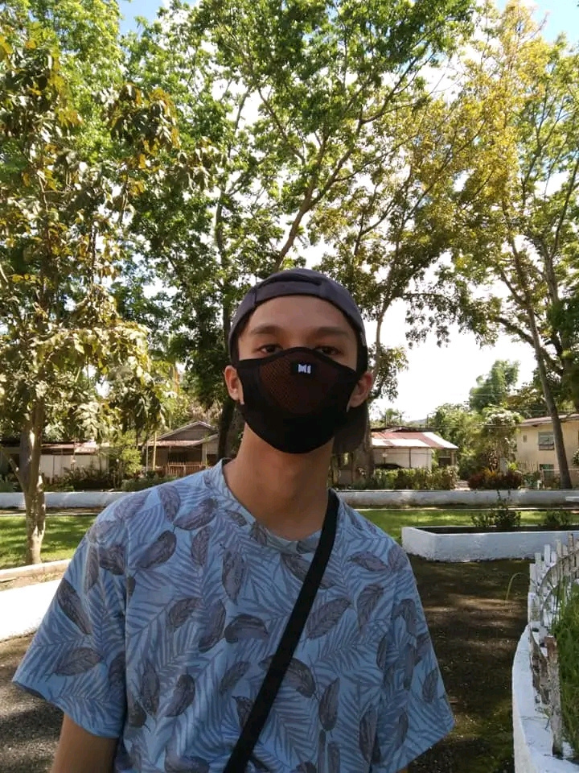

My life's journey
Subject:
Date: 2024 March 7
Ethics
By: Christian James G. Francisco

Slide 2

3rd Stage: Good Boy/Good Girl
In the six stages of moral development, I believe I am currently at Stage 3, Good Boy. As I matured, I’ve remained committed to the values my parents instilled in me to maintain the Good Boy image i have in them. I also study frequently to avoid failing grades because I'm afraid of disappointing my family, who supports my pursuit of graduating. Not only do I study hard to avoid failing, but I also do it because my family allocates their time, money, and effort for me to get to college. Not studying would be disrespectful to their efforts, so every time I get tired, I think of my family that supports me, and I do my best to not betray them. This sense of duty and gratitude propels me to study hard and graduate, not merely for myself but for them, a response to the opportunities afforded to me by their unwavering support.
2

Slide 3

Thank you
for listening

